Slide 1





Sentinels
Zero-shot Composed Text-Image Retrieval
1

Slide 2

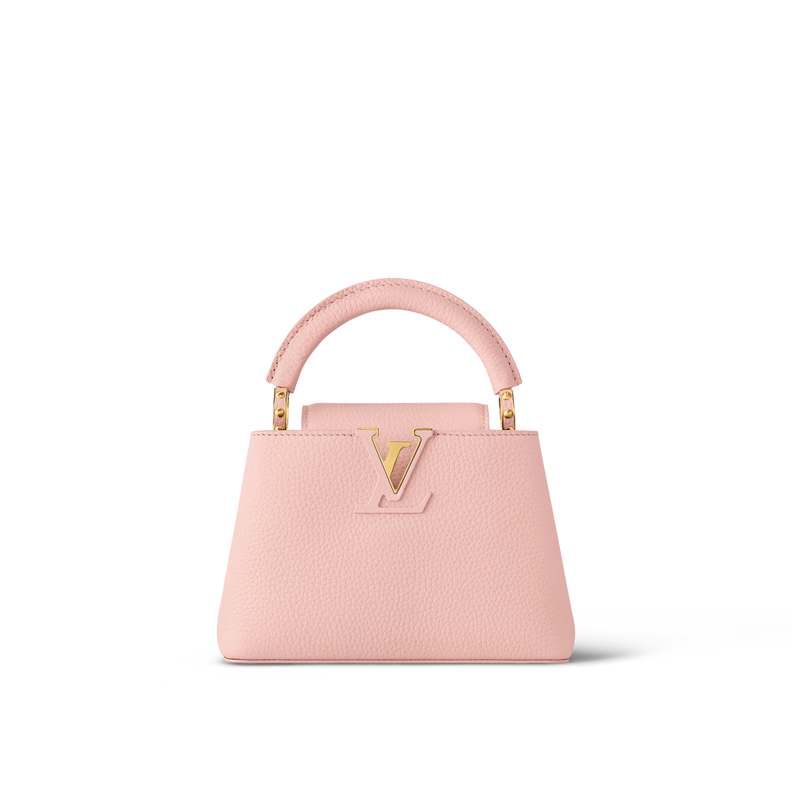
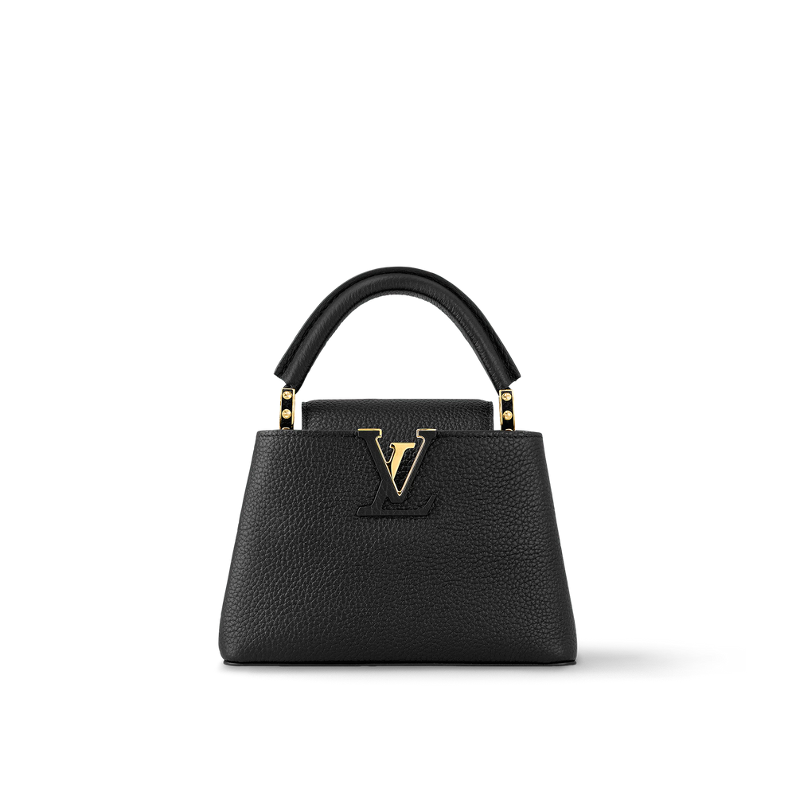

Sentinels
Introduction to CIR
Retrieve images by leveraging a combination of reference image and textual information that illustrates desired modifications
Make it Black
2

Slide 3
Sentinels
Existing Approaches and Their Problems
Supervised models → require large annotated triplets(a reference image, a relative caption, and a target image)
Manually constructing annotation is costly, slow and domain-limited
Weak at generalization (new datasets, unseen domains)
Solution proposed:
Automatic dataset construction from image-caption pairs(e.g., LAION-COCO)
New model: TransAgg with transformer fusion + adaptive aggregation
3

Slide 4
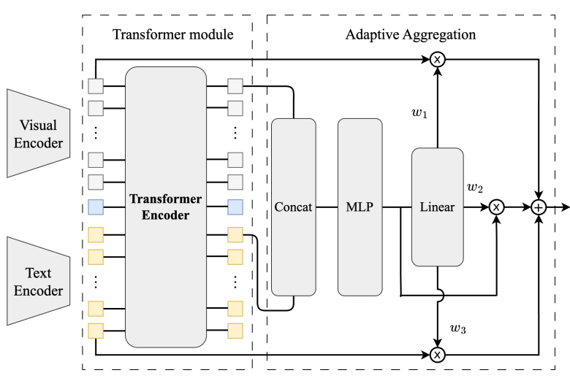
Sentinels
Architecture
Make it Black
4

Slide 5
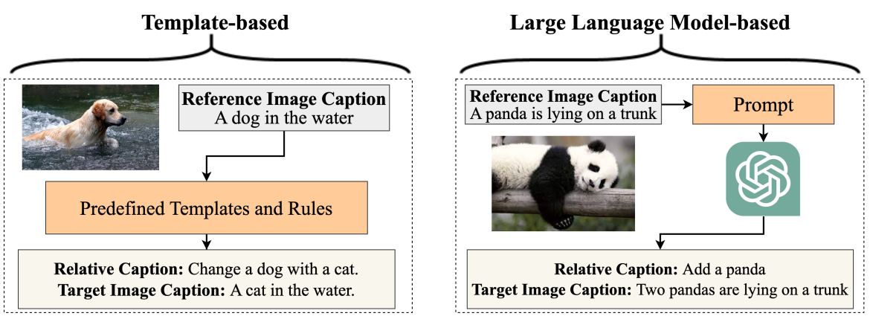
Sentinels
Dataset Construction
Starting with LAION-COCO image-caption pairs
Create “relative captions” using:
Match edited caption with real target image (sentence transformer similarity)
Datasets: Laion-CIR-Template (16k), Laion-CIR-LLM (16k), Combined (32k)
5

Slide 6
Sentinels
Experimental Setup
The authors evaluate on two benchmarks:
CIRR (~36k triplets, general natural images, derived from NLVR2).
FashionIQ (~30k triplets, domain-specific fashion categories: Dress, Shirt, Toptee).
Training Datasets:
Laion-CIR-Template (16k)
Laion-CIR-LLM (16k)
Combined (32k)
Zero-shot evaluation: The model is trained only on the automatically built Laion-CIR datasets, then directly tested on CIRR and FashionIQ—no fine-tuning.
Metrics: Recall@K (standard retrieval metric)
6

Slide 7
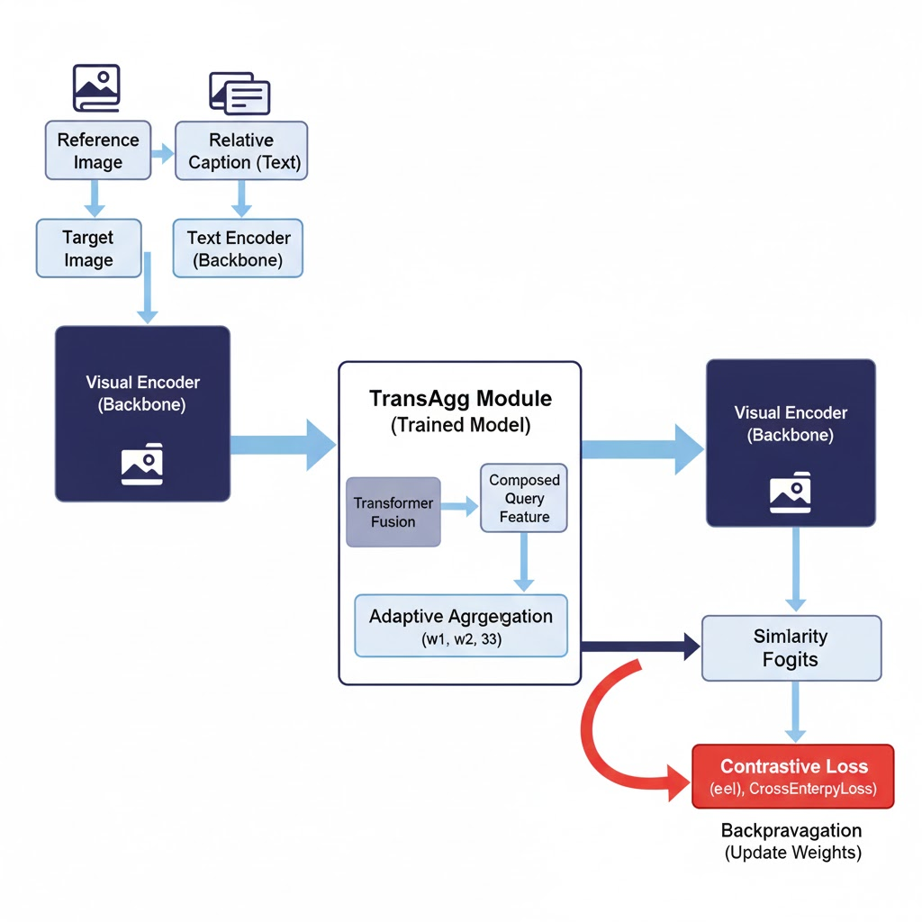
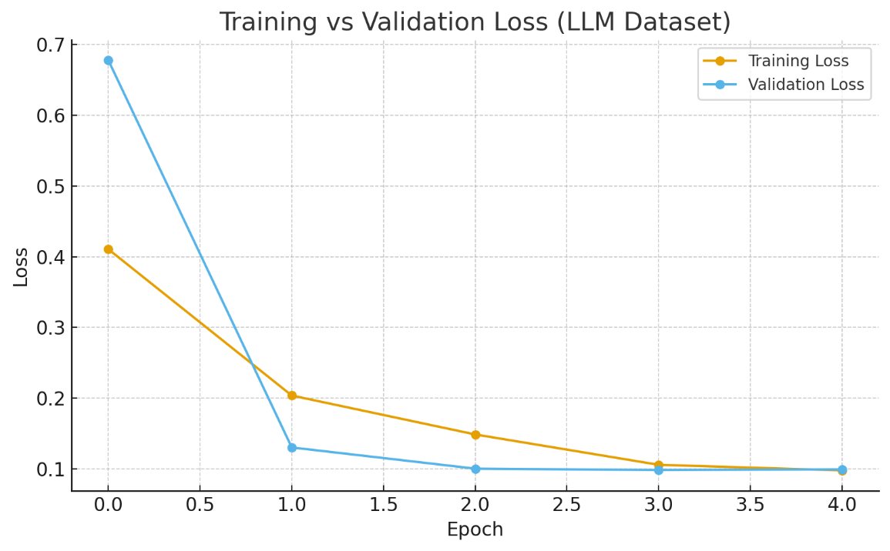
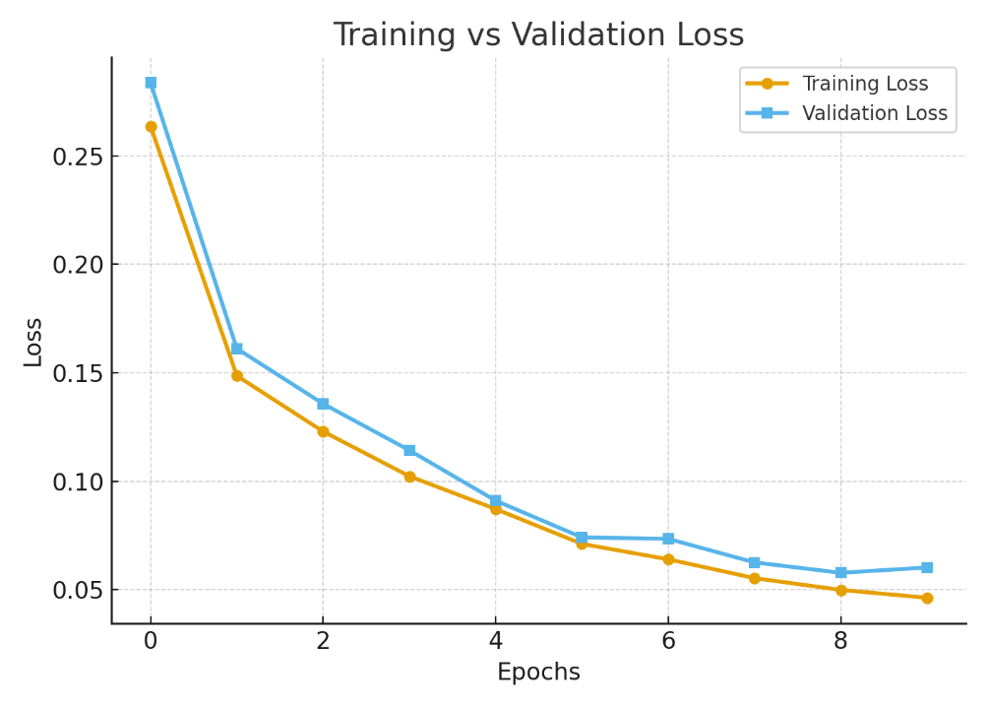
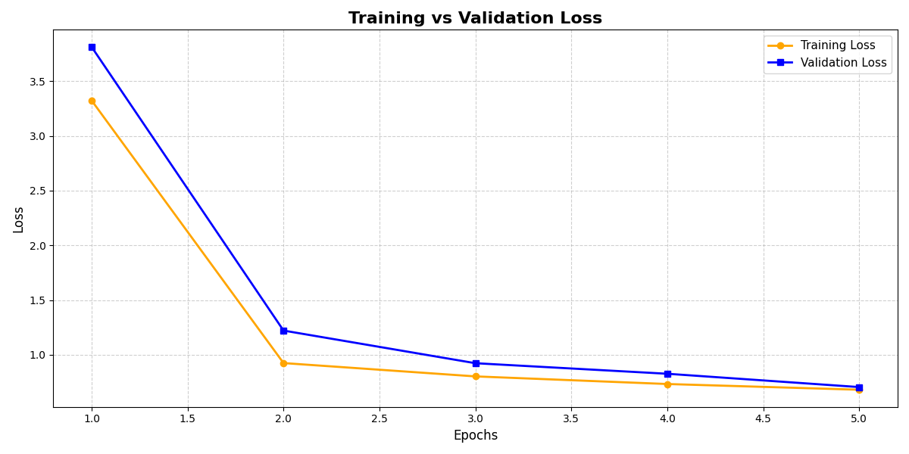
Sentinels
Training
We used clip-Vit-B/32 and Blip as based models
6

Slide 8
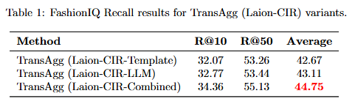
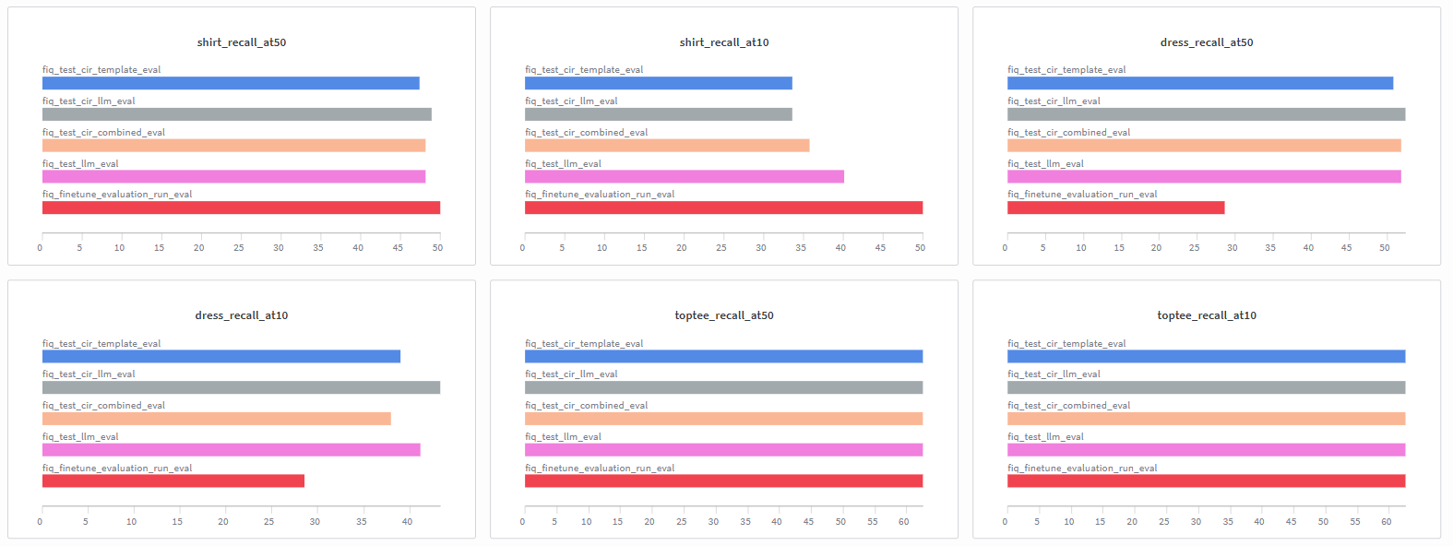
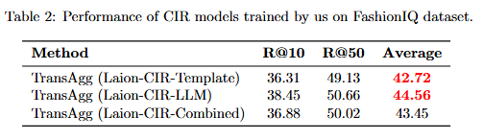
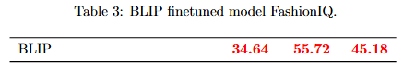
Sentinels
Comparison
6

Slide 9
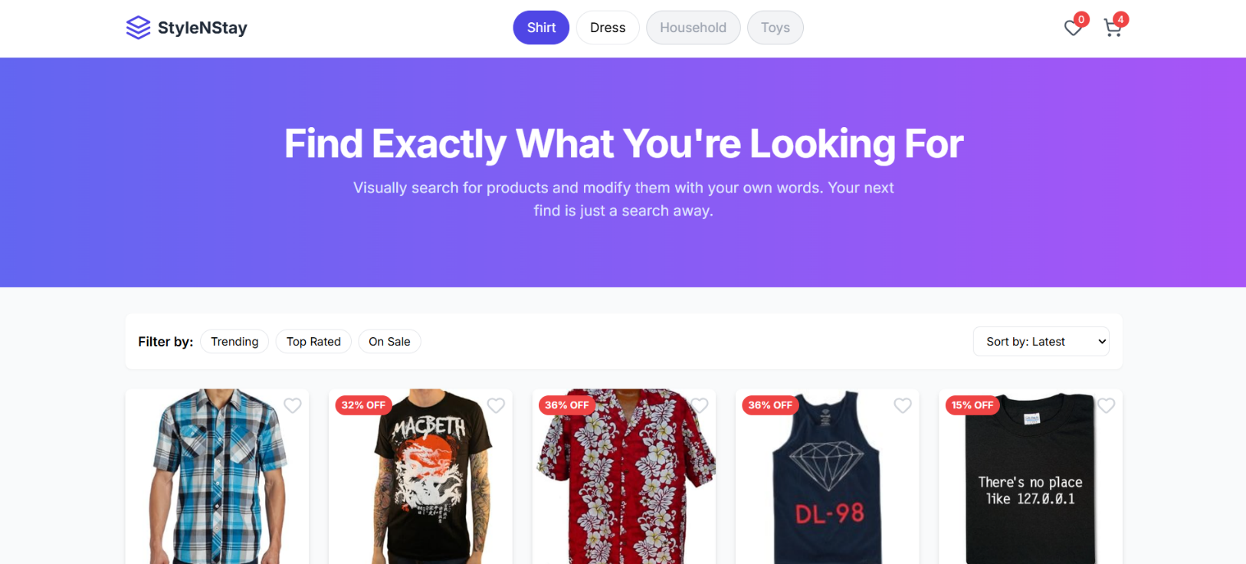
Sentinels
Novel Application
An e-commerce app like Daraz or AliExpress where users can explore thousands of fashion items.
Instead of relying purely on text searches, our system lets customers refine their product search using both an image and natural language edits.
This approach enables:
Multimodal search (image + text combined).
Fine-grained product discovery based on visual semantics.
Improved personalization since users can describe how they want an item changed.
6

Slide 10
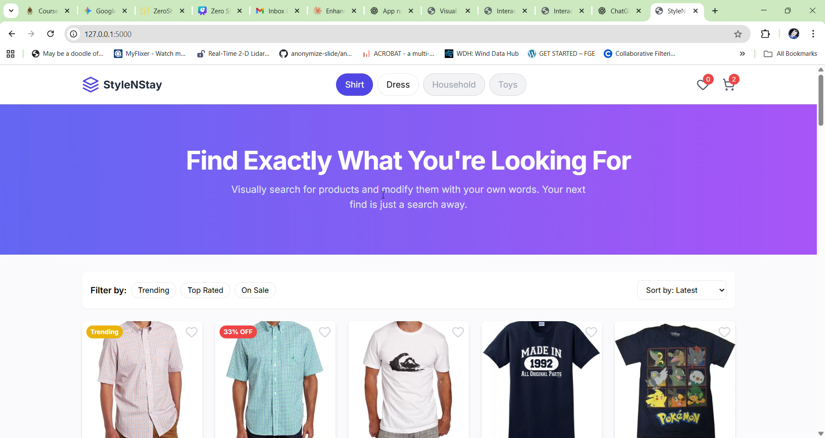
Sentinels
Demonstration
6

Slide 11
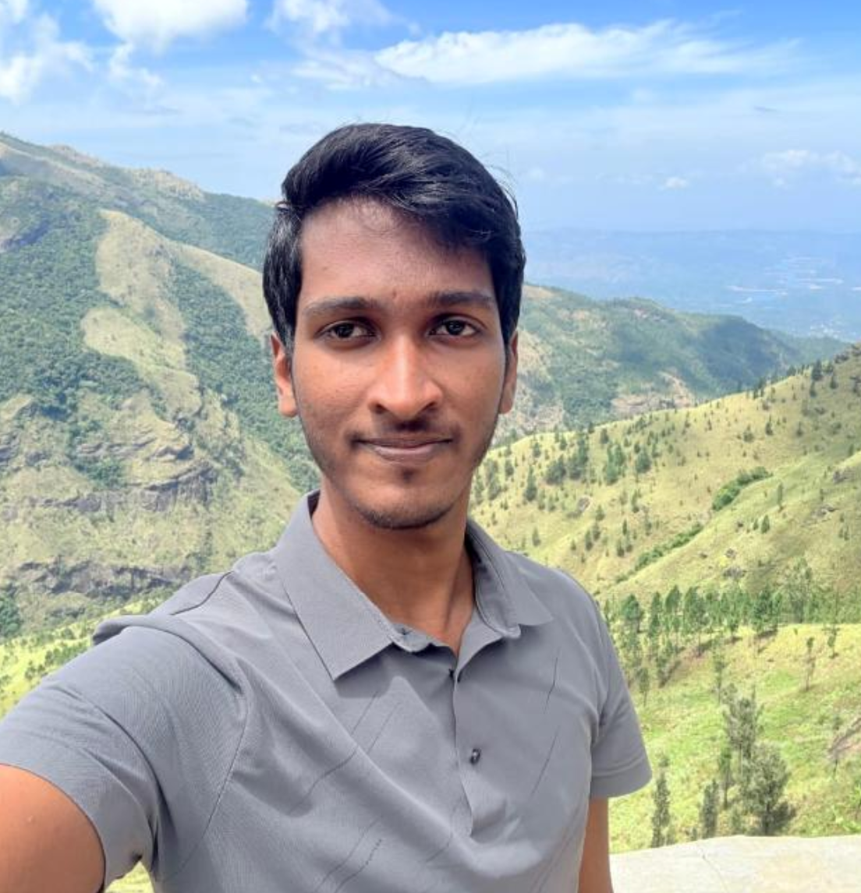
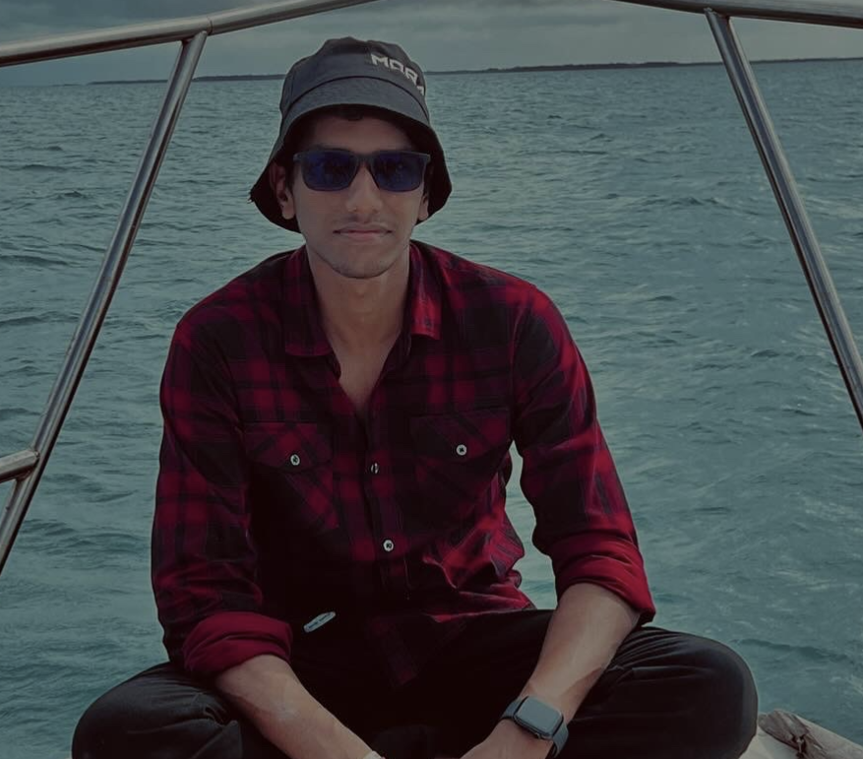
Sentinels
Contribution
Kuruppuarachchi K.A.R.R (220350T) – Model final evaluation with fiq dataset and e-commerce applications
Kumarage R.V (220343B) – Model Training (combined and llm)
7

Slide 12
Sentinels
Thank You !
7

